Slide 1
PANIMALAR ENGINEERING COLLEGE DEPARTMENT OF CSE 21CS1512-SOCIALLY RELEVANT MINI PROJECT A SENTIMENTAL ANALYSIS ON PRODUCTS AND MARKET INSIGTHS
DONE BY:
A.PRIYADHARSHINI(211422104359)
N.Rubika(211422104410)

Slide 2
Abstract:
In today's fast-paced world, consumers face challenges when comparing multiple products. This project simplifies the process by creating a web-based tool that helps users compare products based on specific features. Using HTML and CSS for the frontend and Python Flask for the backend, the tool analyzes data from a CSV file containing product details like name, price, model, and features. Users input product information, and the system retrieves similar products from the same category, presenting a comparison table with key details. This user-friendly tool reduces research effort and enhances the shopping experience by automating product comparisons.
The tool’s flexibility allows for future expansion, making it suitable for broader commercial use. Additionally, it showcases the integration of web technologies with data processing to deliver a practical solution to common consumer challenges.

Slide 3
ARCHITECTURAL DIAGRAM
Web scraping
Python Libraries
Data Storage
(CSV file)
Data Analysis
Sentiment Analysis
(by category)
User Interface
(Report)
Visualization
Product Comparison

Slide 4
Existing system:
The existing system for product comparison typically involves manual research by consumers, requiring them to visit multiple websites or stores to compare product details such as price, features, and user reviews. Many e-commerce platforms offer limited comparison tools that only display basic information, often without a detailed analysis of advantages and disadvantages. Users may rely on third-party review sites or product forums, which can be time-consuming and prone to biased opinions.
As a result, consumers often struggle to make informed decisions. Additionally, current tools lack personalized input, such as filtering by specific features like color or model, leading to generalized results that may not meet user preferences. This fragmented approach creates a less efficient and often frustrating shopping experience.

Slide 5
Proposed system:
The proposed system in this project offers a streamlined, web-based product comparison tool that allows users to easily compare similar products based on personalized input. By integrating a frontend built with HTML and CSS, and a backend using Python Flask, the system retrieves and analyzes data from a CSV file containing comprehensive product details like name, price, model, color, advantages, and disadvantages. Users can input specific criteria such as product name, category, price, and model, and the tool will generate a comparison table highlighting relevant products from the same category.
This system automates the comparison process, saving users time and effort while providing clear insights for more informed decisions. The user-friendly interface and efficient backend make it accessible for a wide audience, with potential for expansion into larger retail applications.

Slide 6
MODULES:
1. User Input Module: This module collects product details from users including product name, category, price, model and color. It ensures data validation and accuracy to provide the necessary input for comparisons.
2. Data Retrieval and Processing Module: This module reads the CSV file containing the product data. It filters and processes the data based on the user’s input, extracting relevant product information such as price, model, advantages and disadvantages.
3. Product Comparison Module: This module performs the comparison of products within the same category. It defines similar products and organises their details into a comparison table, highlighting the key features and differences to aid decision making.

Slide 7
4. Frontend Display Module: This module handles the presentation of the user interface using HTML and CSS. It displays input forms for users and presents the comparison table in an easy-to-understand layout, ensuring a user-friendly experience.
5. Backend Integration Module: This module connects the frontend with the backend using flask. It handles communication between the user's inputs and the backend processing, ensuring that the CSV data is accessed, filtered, and displayed correctly on the web interface.

Slide 8
HARDWARE AND SOFTWARE REQUIREMENTS
Hardware Requirements:
Processor: Intel Core i3 or higher (or equivalent)
RAM: 4GB or more (8GB recommended for smoother performance)
Internet Connectivity: Required for accessing online resources or deploying web services
Software Requirements:
Operating System: Windows 10/11, macOS, or Linux
Programming Language: Python 3.x
Web Framework: Flask (for Python-based backend development)
Frontend Development: HTML, CSS (for building the user interface)
Database/Storage: CSV file (for storing product data)
Text Editor/IDE: Spyder, VSCode, PyCharm, or any Python-supported editor
Browser: Google Chrome, Firefox, or any modern web browser (for testing and using the web app)
Python Libraries: pandas, Flask, and any other dependencies required for CSV handling and web development

Slide 9
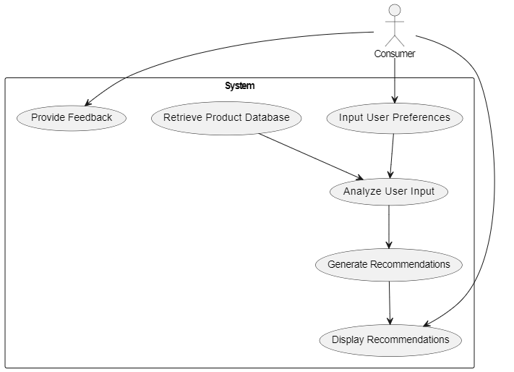
Uml diagrams
Use case diagram

Slide 10
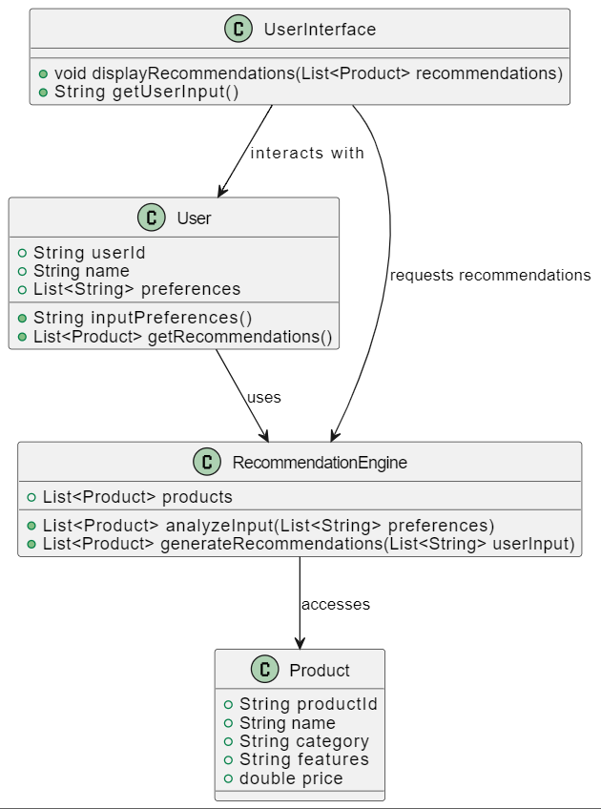
CLASS DIAGRAM

Slide 11
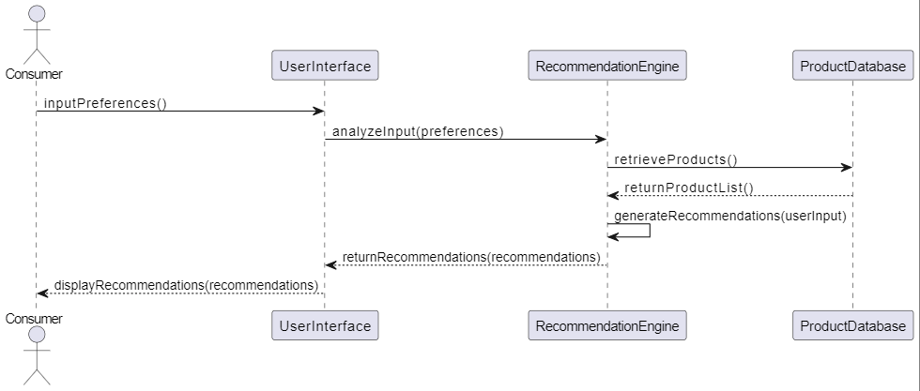
SEQUENCE DIAGRAM

Slide 12
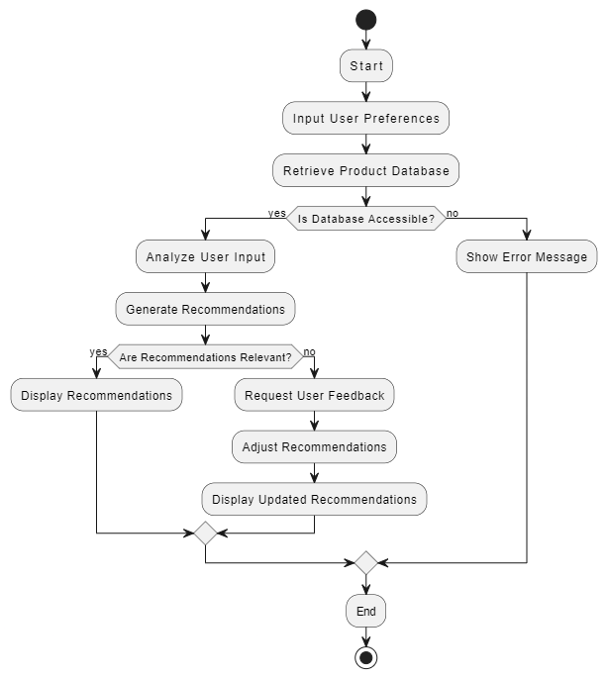
ACTIVITY DIAGRAM

Slide 13
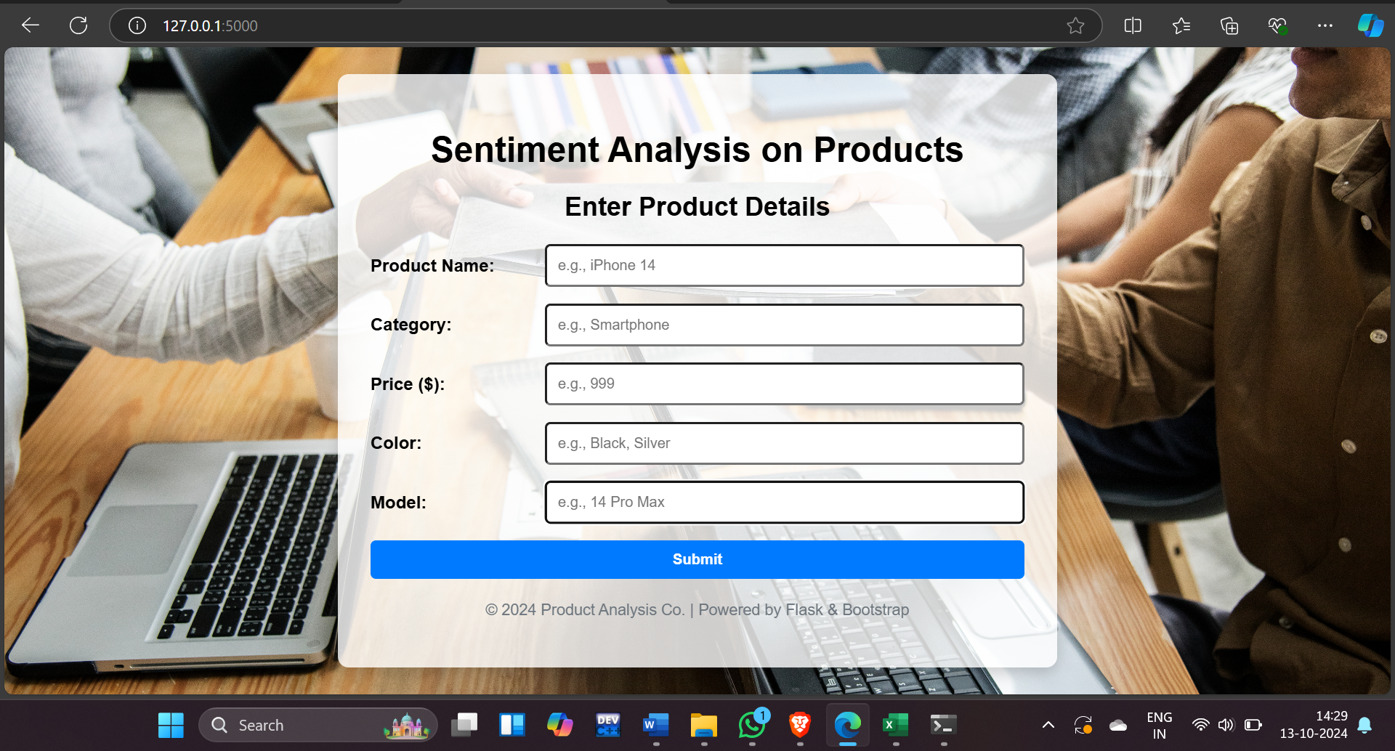
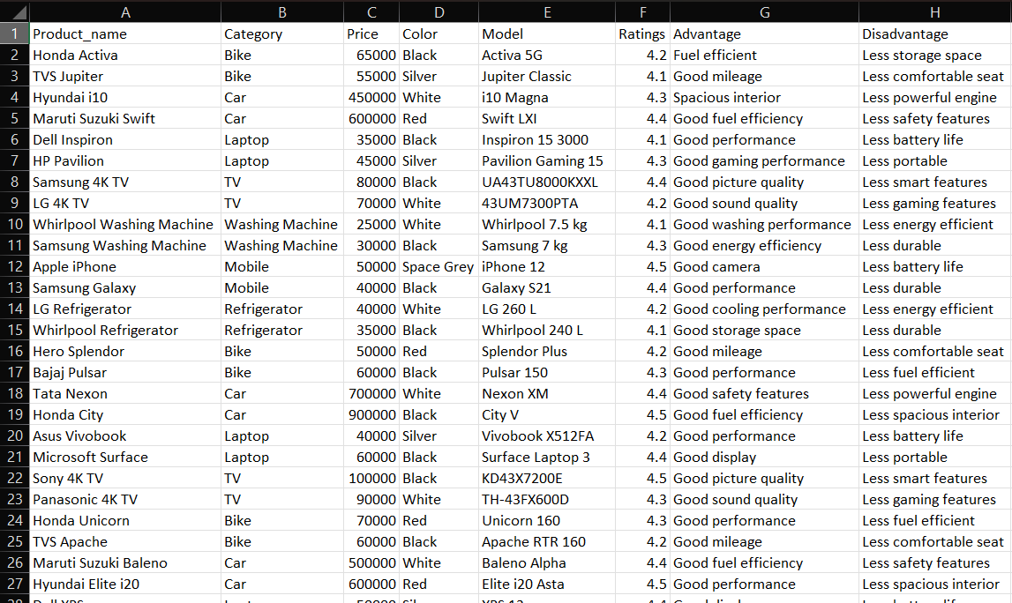
screenshots
FRONT-END
CSV FILE

Slide 14
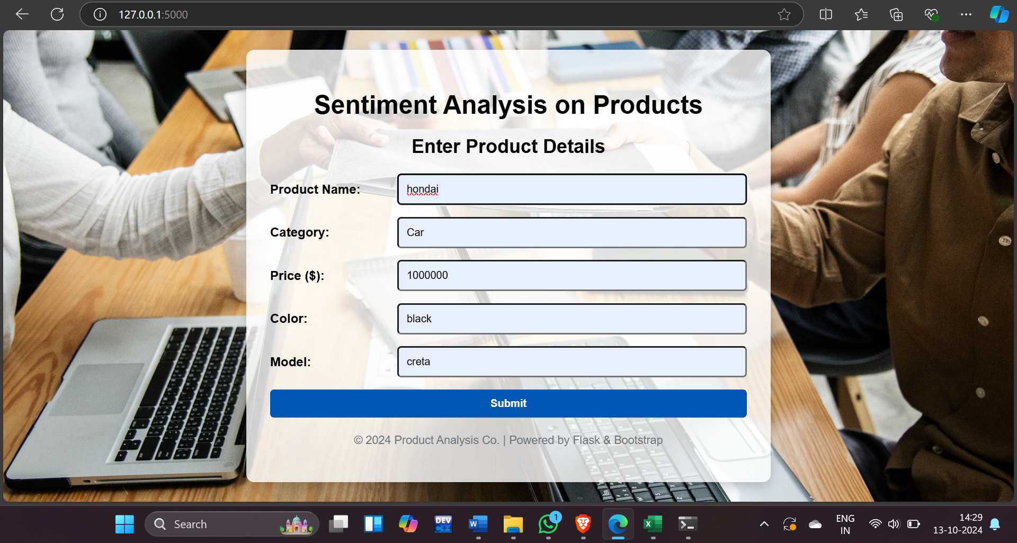
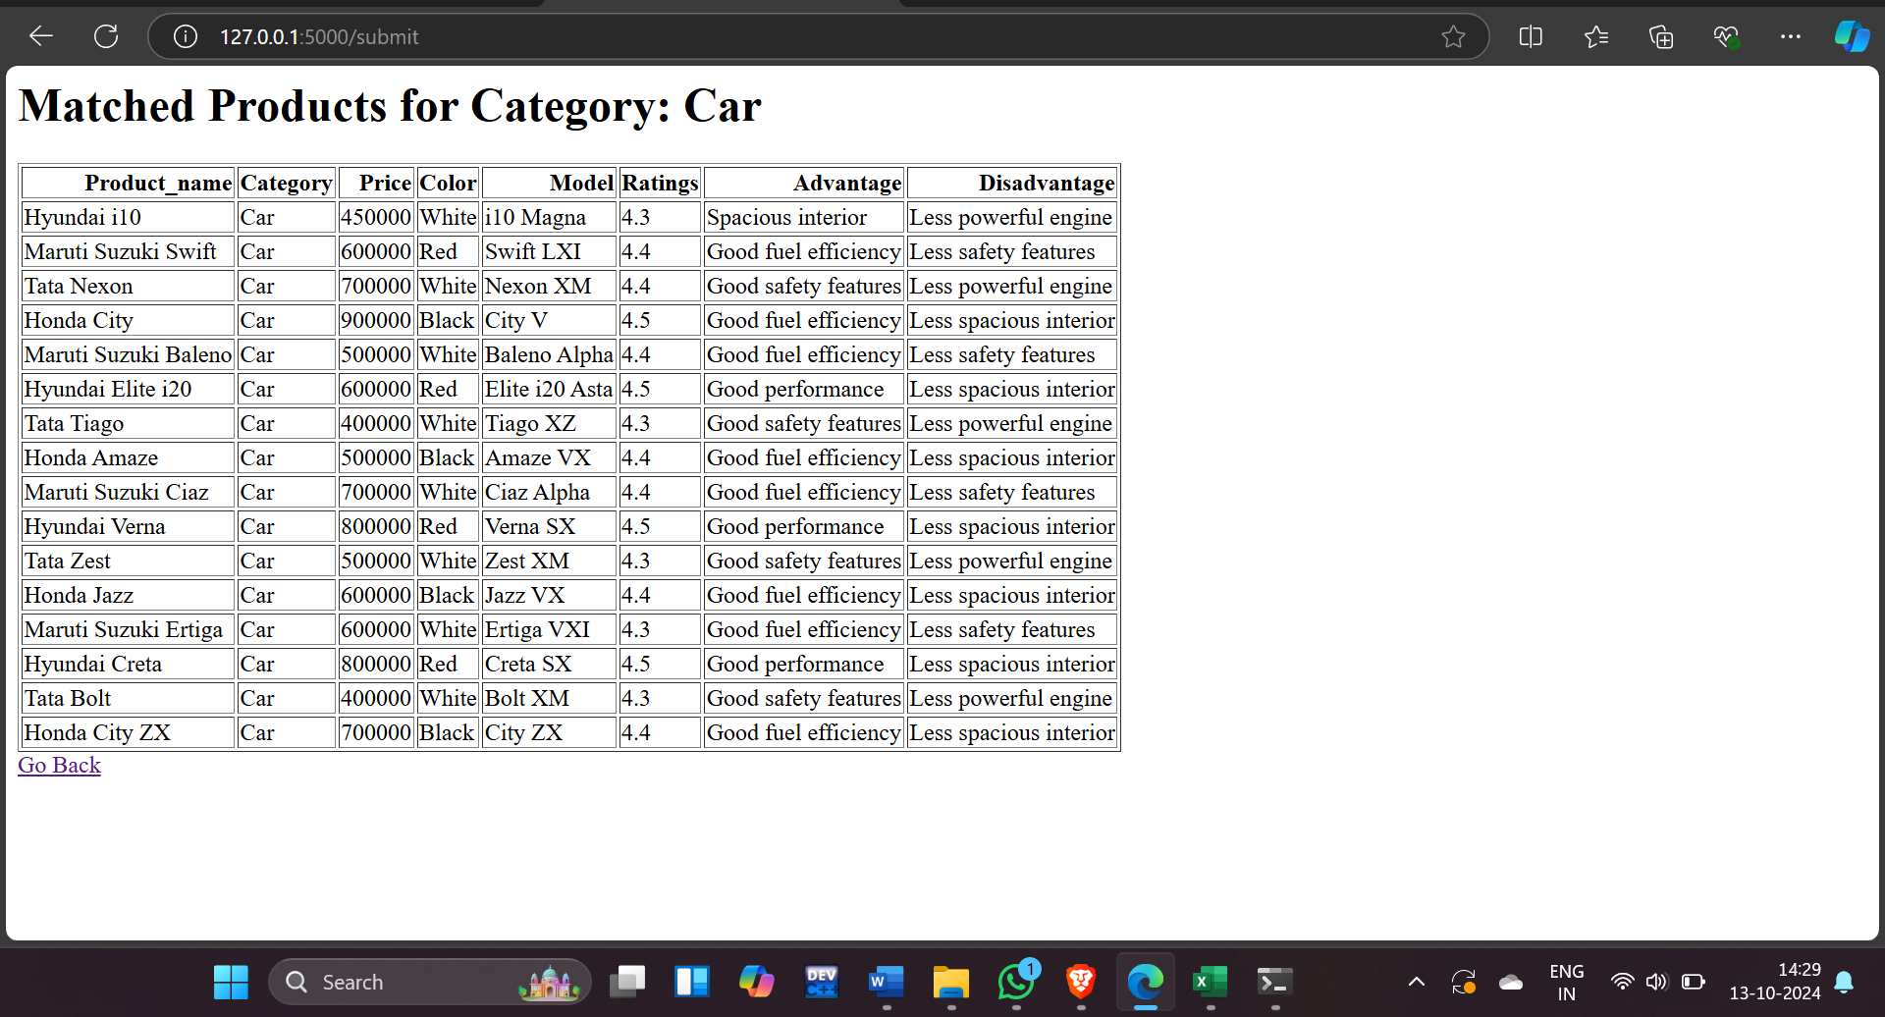
USER INPUT
OUTPUT

Slide 15
CONCLUSION
In conclusion, this project successfully addresses the challenge of product comparison by providing a user-friendly web-based tool that automates the process. By integrating HTML and CSS for the frontend and flask with python for the backend, it efficiently handles data from a CSV file to compare similar products based on user input. The system's ability to present key product features such as price, model, color, advantages, and disadvantages in a clear comparison table enhances decision-making for consumers. The tool not only simplifies product research but also saves users time and effort. With potential for expansion and scalability, the project offers a solid foundation for future development in e-commerce or retail environments.

